Slide 1
Malawi Rapid Testing
Provider and Site Certification Framework

Slide 2
Outline
Description of Rapid Testing Quality Improvement initiative
Explain the purpose of certification
Components of Site and Personnel Certification
Withdraw of certificate
Certification process

Slide 3
What is Rapid Testing Quality Improvement Initiative?
An innovative approach to ensure reliable and accurate test results
Includes;
  Quality assurance
  Development of a National Certification Framework for Testing providers and Testing sites
Framework based on WHO guidelines

Slide 4
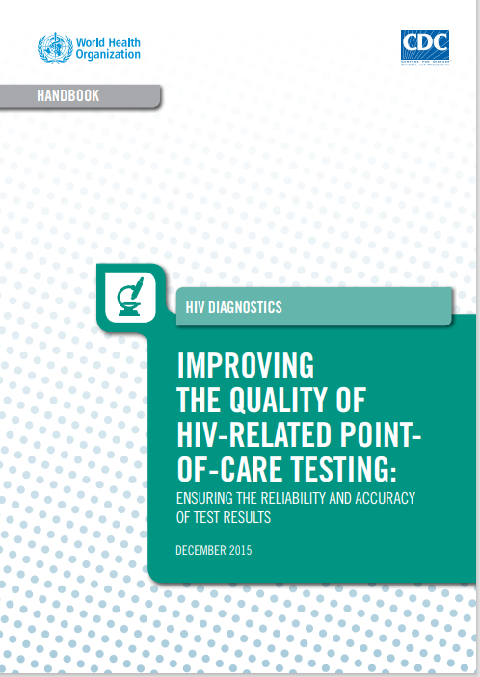
Purpose of Certification Framework
To provide guidance that will establish and/or strengthen national certification program for HIV rapid testing site and provider for Malawi as recommended in the WHO handbook. The aims were to inform the development of policies, processes and procedures for the implementation of a national certification program for HIV test providers and sites.

Slide 5
The Framework seeks to
Provide multiple possible approaches to achieve national certification of testing sites and providers including the Quality Management Approach
Strengthen existing testing site and provider certification practices
Highlight the importance of leveraging existing resources to achieve certification and related quality improvement targets; and
Share recommended best practices and tools in the areas of testing site and provider certification program development, planning, implementation and monitoring & evaluation.

Slide 6

Components of Certification Initiative
The certification initiative has two components
Personnel certification
Site certification

Slide 7
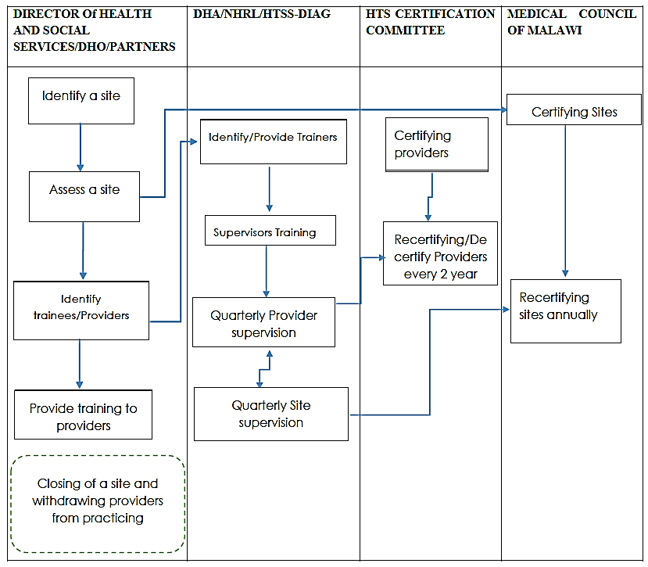
Certification Process

Slide 8
Personnel Certification

Slide 9

Key Players for Certification (1)
Testing Certification Committee
  Personnel certification
  Director DHA, Director of quality improvement, Diagnostic, NHRL
  They can delegate duties to the National Trainers and Supervisors
Medical Council of Malawi
  Site Certification

Slide 10
Key Players for Certification (2)
Director for Health and Social Services
  Meeting requirements for both site and
personnel certification
Implementing Partners
  Support in Training, Supervision, Mentorship
and provision of other testing supplies

Slide 11






HTS Provider Training
All trainings use nationally approved standardized training curricular (provided by HIV and AIDS Department)
INITIAL TRAINING
SELECTION CRITERIA
REFRESHER TRAINING
SUPERVISORS TRAINING
TRAINER-OF-TRAINERS (TOT) TRAINING
MASTER TRAINERS TRAINING
3 weeks of theory and 1 week of practical sessions
Direct observation during testing process
Role plays during classroom sessions o Written: multiple-choice and short answer questions with a passing mark of 70%
Practical: Minimum of 5 unknown specimens (PT) with a 100% passing mark and Session observations with 80% passing mark
After successfully completion of the training, HTS providers are expected to perform HTS under supervision for the first 3 months
Medical - Have a certificate in any medical discipline, that is, nurse, clinical officer, medical assistant, doctors, dental therapist, environmental health officer, and Laboratory officers
Be a Malawi School Certificate of Education holder
o Foreigners must have at least one year’s experience staying in Malawi and conversant with the culture
Conducted every 2 years
3 days training using skills intensive
Direct observation during testing process
Certification examinations include both written and practical sessions.
Written: multiple-choice and short answer questions with a pass mark of 80%
Practical: Minimum of 5 unknown specimens (PT) with 100% pass mark
5 days training using MOH approved supervision curriculum
At least 1 year experience working as an HTS provider
Certification examinations are written short answer questions with 80% pass mark
2 weeks training using MOH TOT curriculum
At least 1 year experience working as a HTS supervisor
Certification examinations are mainly teach-backs (microteaching) with a pass mark of 80%
Should be a trainer of trainers
At least 1 year experience as a trainer of trainers
Competence based (conversant with Malawi HTS program)
Training based on current HTS guidelines
Certification based on examinations and teach backs with a pass mark of 80%

Slide 12
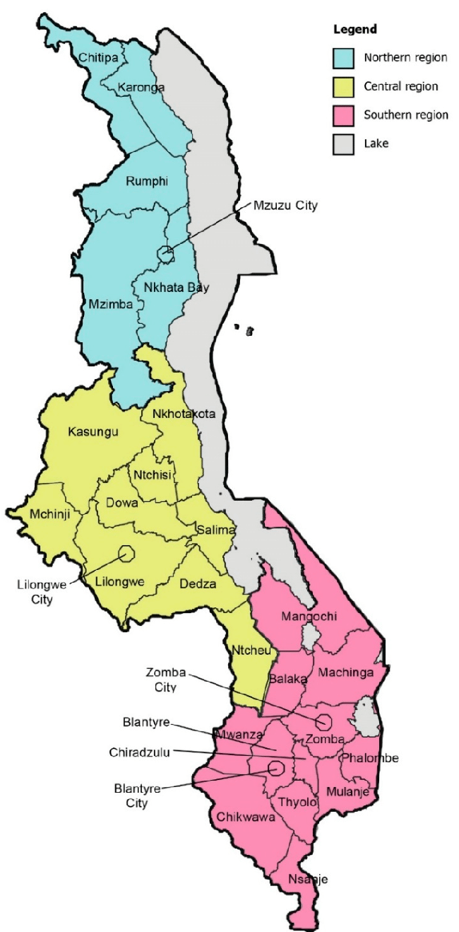
Provider Certification Hierarchy
HTS CERTIFICATION COMMITTEE (NATIONAL LEVEL)
ZONAL HTS SUPERVISORS/AUDITORS
DISTRICT HTS SUPERVISORS /AUDITORS (DISTRICT LEVEL)
SITE HTS SUPERVISOR/ AUDITOR (FACILITY LEVEL)
SITE HTS PROVIDER (SITE LEVEL)
HTS IMPLEMENTING PARTNERS (IPS)

Slide 13
Personnel Certification
All providers will be re-certified every 2 years upon:
  Passing the refresher training (80% theory & 100% practical)
  Passing 4 Proficiency Tests (PT) in the 2-year period
  Testing at least 10% of total clients tested at any entry point in the 2-year period

Slide 14



Withdrawal of Certification
Certificates of Testing providers may be withdrawn if any of the following occurs:
      Repeatedly poor performance during national certification examination process
      Lack of participation in national re-certification process without valid reason which shall be assessed and determined by the Malawi Testing Certification Committee
      Lack of successful completion in national recertification process

Slide 15
Site Certification

Slide 16
Site Certification criteria
Meet requirements of Malawi Integrated Testing guidelines and Medical Council of Malawi (MCM)
Minimum of 2 Testing providers per site
Director for Health and Social Services (DHSS) should raise a requisition for site certification to Certification committee
Site certificate is valid for 1 year
Should have reached level 4 of Step wise Initiative for Rapid Testing (SPI-RT) Checklist
  The HTS site compliance with quality standards for HTS certification is measured using the SPI-RT checklists. while other POCT services use the SPI-POCT checklist.

Slide 17
Site Scoring Criteria
Levels | % Score | Description of results
Level 0 | Less than 40% | Needs improvement in all areas and immediate remediation
Level 1 | 40% - 59% | Needs improvement in specific areas
Level 2 | 60%-79% | Partially eligible
Level 3 | 80%-89% | Close to national site certification
Level 4 | 90% or higher | Eligible to national site certification
Notes:
Refer to the SPI-RT checklist

Slide 18
Monitoring and Evaluation Tools for HTS Certification Initiative
Monitoring and Evaluation (M&E) assesses the efficiency, effectiveness and relevance of a national certification program. The M&E practices for sites are:
  Training records from provider logbooks and photocopies of counselling certificates
  Quarterly site supervision tools which includes Stepwise Process for Improving the Quality of HIV Rapid Testing (SPI-RT), national HTS supervision
  QCs and PTs records
  Competency reassessment through logbooks

Slide 19
HTS Providers Data
HTS provider database is updated at both National HIV Reference Laboratory and HIV and AIDs Department’ HTS office.
Before and after each PT panel distribution, NHRL updates its database to reflect those participating in Proficiency Testing

Slide 20
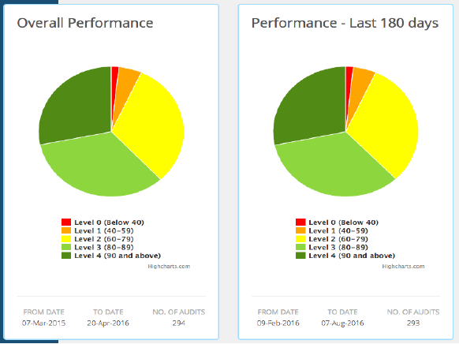
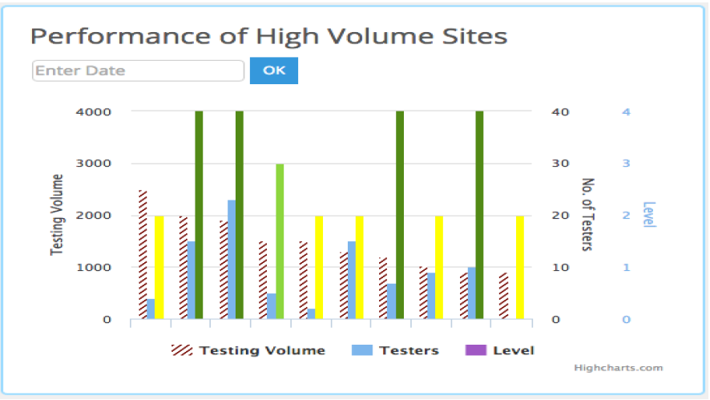
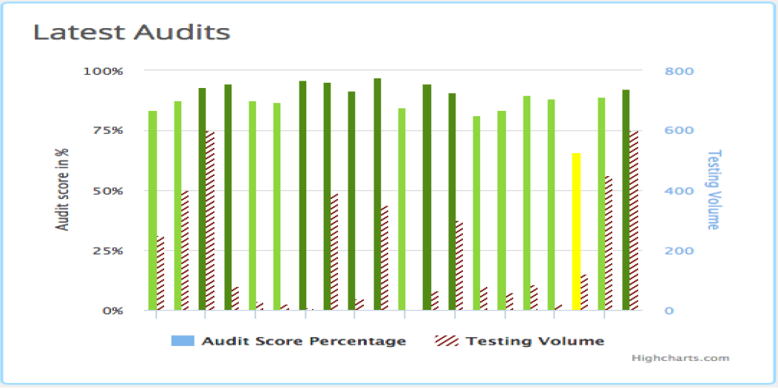
DATA Management
DASHBOARD FOR QUALITY IMPROVEMENT OF HIV RAPID TESTING
Overall performance chart of audits in a form of pie chart. This section displays the pie charts for quick Performance of (Overall, last 180 days and last 30 days), users can filter performance by Date Range,
Performance of high-volume sites, displayed as bar graph with testing volume, testers and levels and can filter the data with date.
Latest audits displayed in bar graphs with audit score(level) and testing volume
A quick overview of how labs are performing over time and against the different sections of SPI-RT Checklist.
Option to edit the corrective actions and add or remove corrective actions
The data is uploaded to the cloud server and published to Malawi Dashboard for Quality Improvement of HIV Rapid Testing where it is analyzed, visualized and reported.

Slide 21
Future of site and personnel certification
Once testing providers have been licensed Regulatory body will be responsible for regulating testing personnel.
Lab Assistants to do POC HIV testing.

Slide 22


